Slide 1
Lvl 4/5 Group 14 IMDCGD111-16YRD
Alex Polley, Henry Crofts and Michael Curtis

Slide 2
Demographic
Male Teenagers 13 - 18
Already have an interest in competition which often increases with age
Teens both male and female are interested in new experiences that can happen through gameplay
(Schell 101,103)

Slide 3
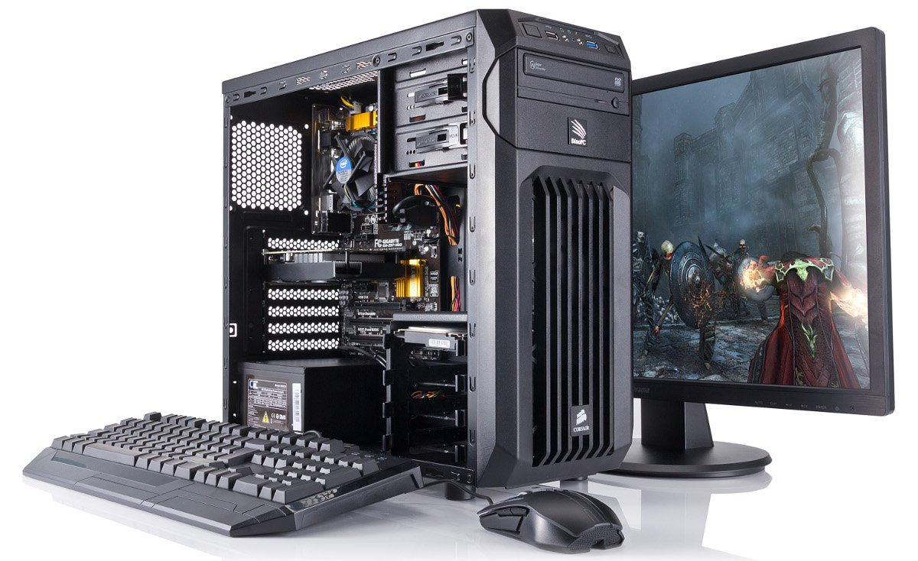
Platform

Slide 4
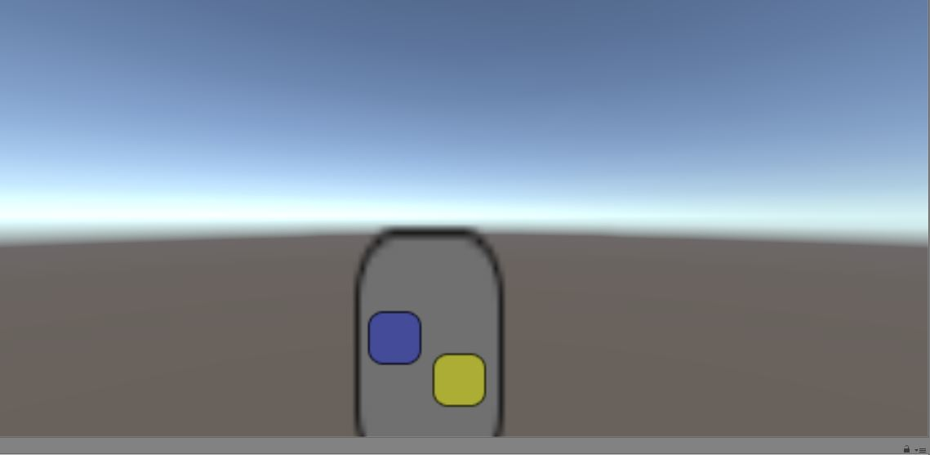
Previous Concepts
Friction Game
Twitch mechanic
Players must move their piece across a pathway with varying resistances
The resistance is overcome by rapid tapping on the screen
First player to reach the end is the winner

Slide 5
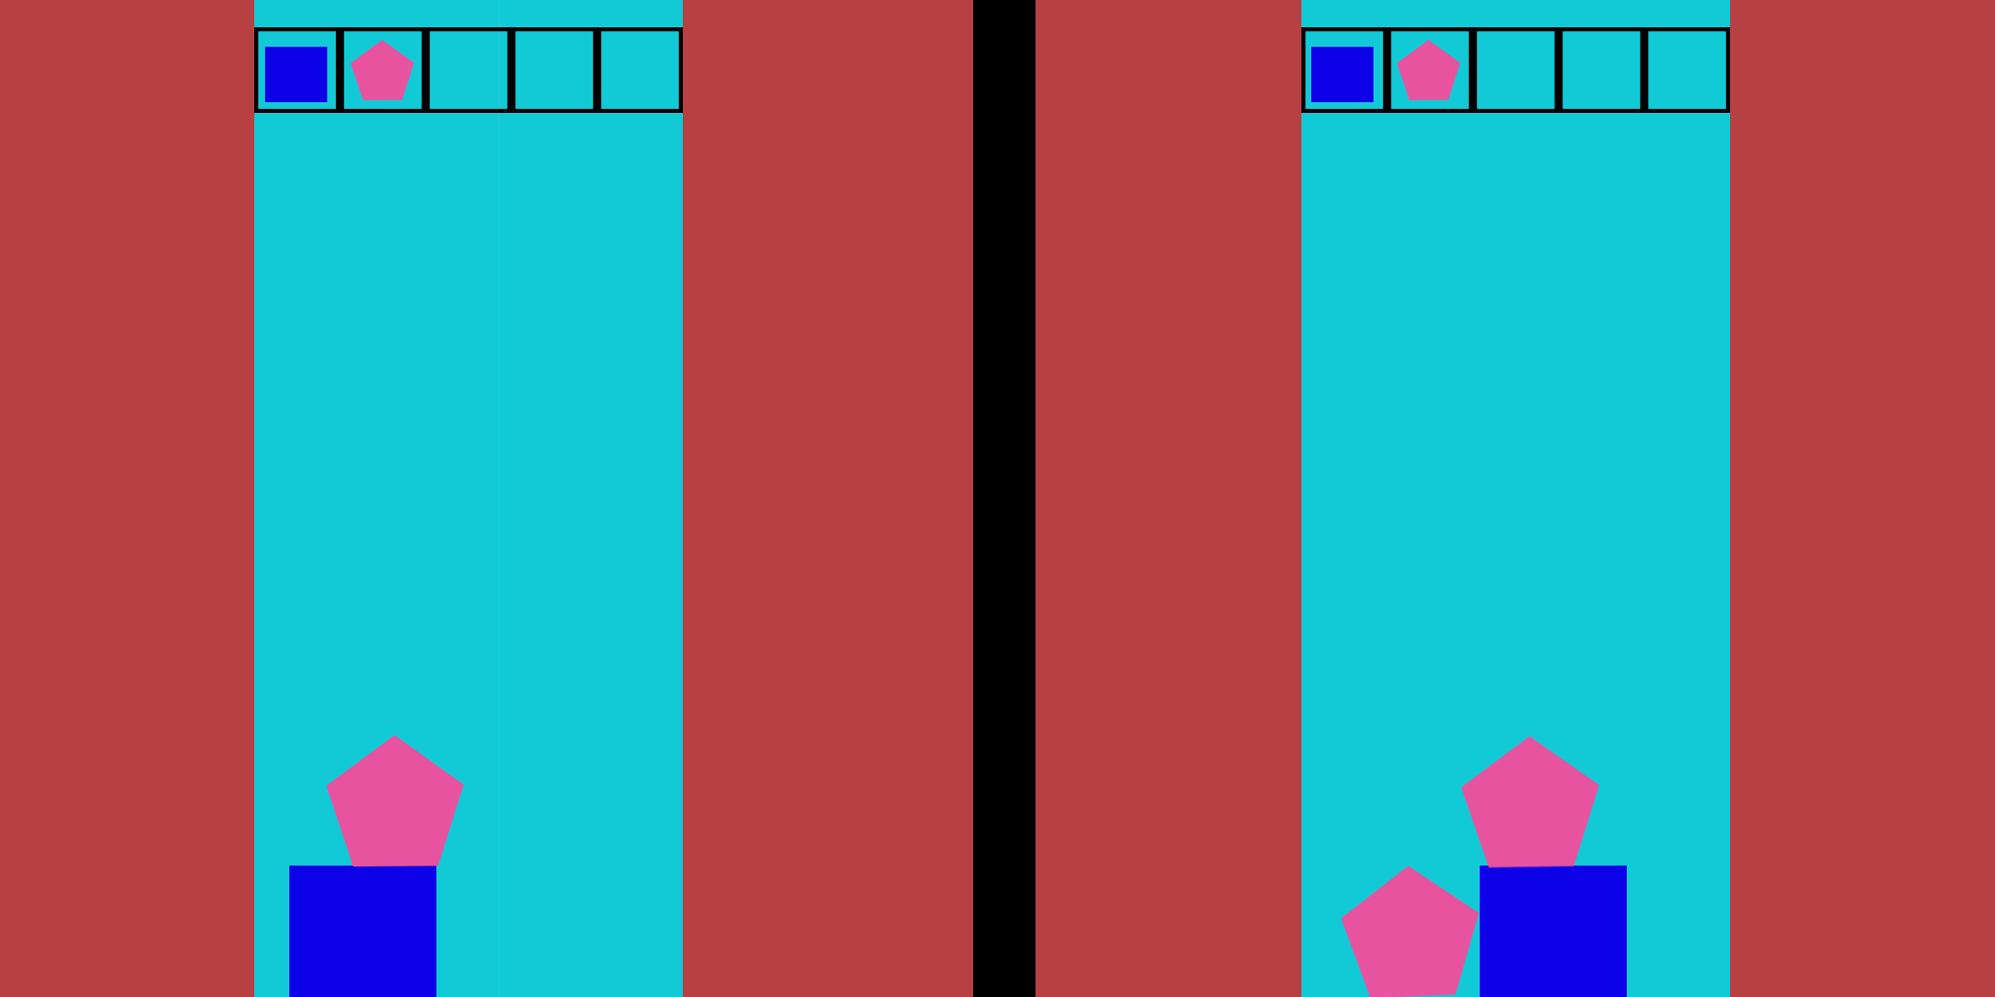
Previous Concepts
Gravity Game
Our gravity based game is a tower building game
Players must try and balance shapes they are given
If one player chooses a shape the other player must also use that shape

Slide 6
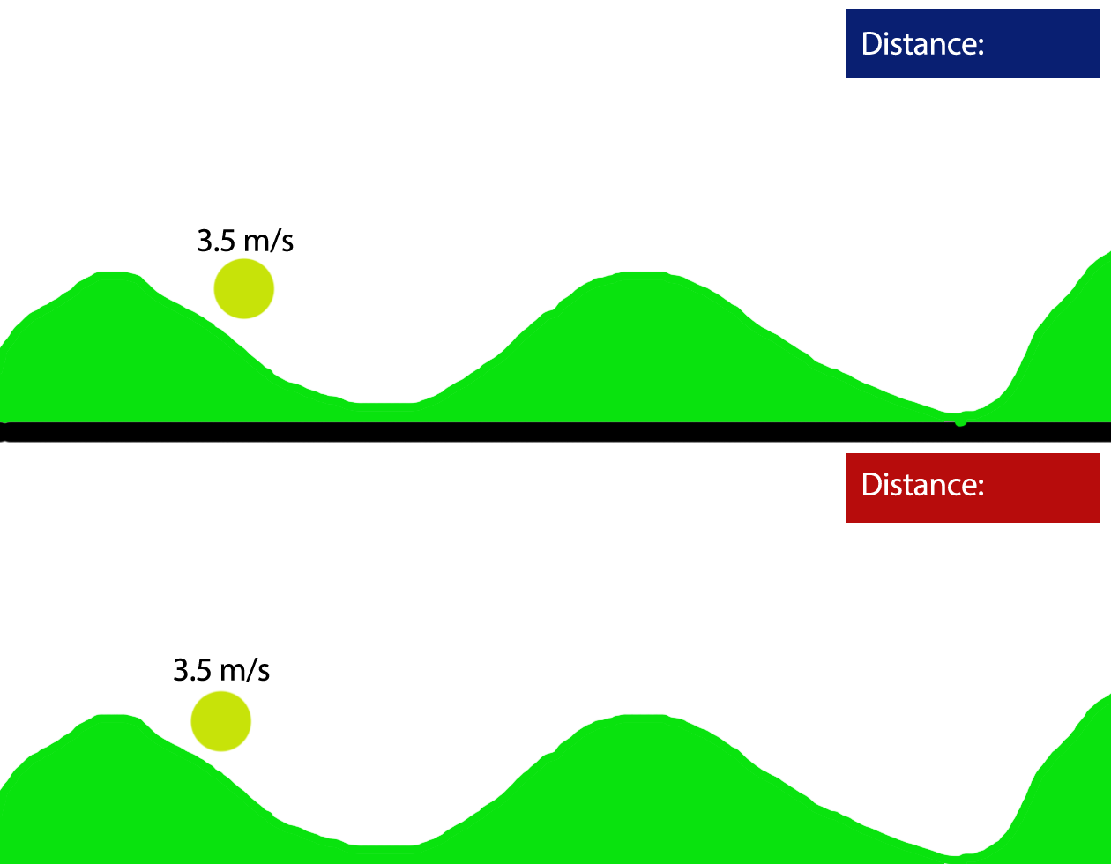
New Concept

Slide 7
Meeting the Brief
Simultaneous Gamplay
Adversarial
Symmetrical

Slide 8
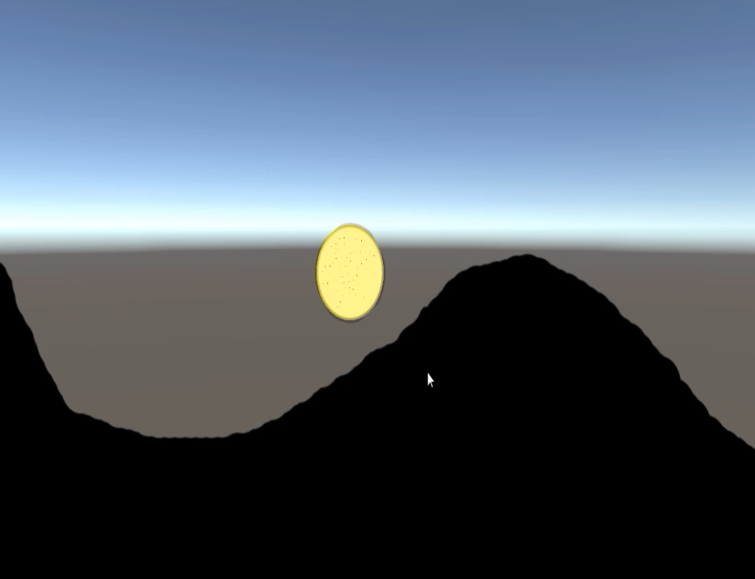
Initial Prototype

Slide 9
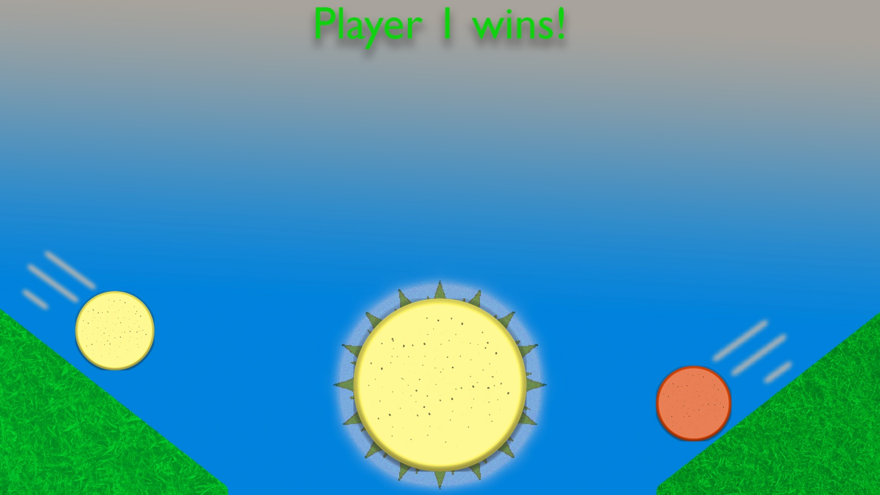
Theme
British Summer Time

Slide 10
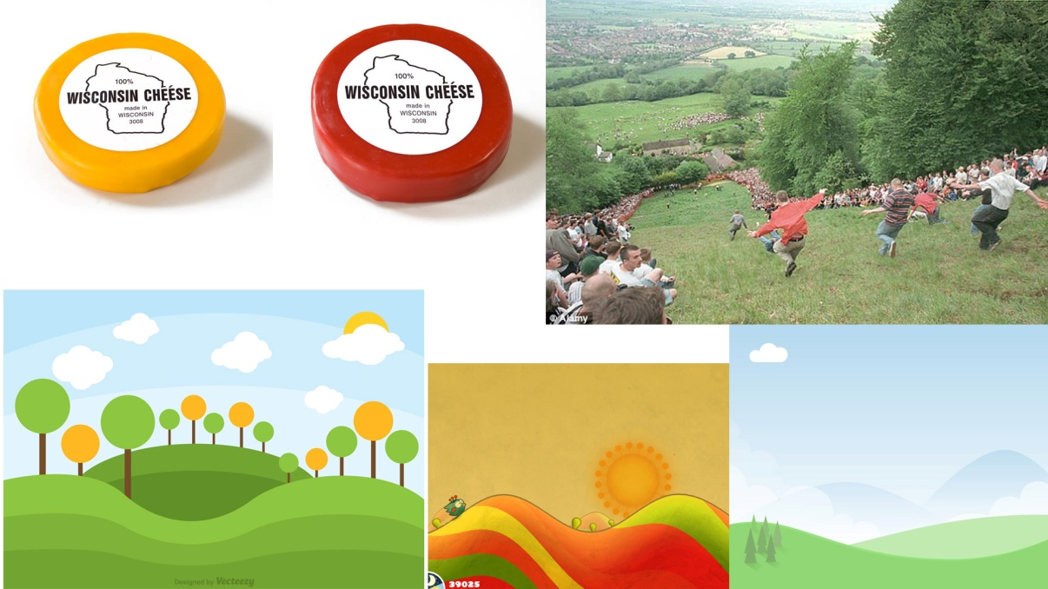
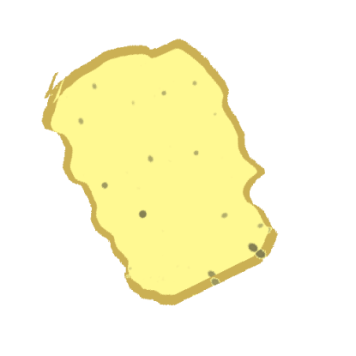
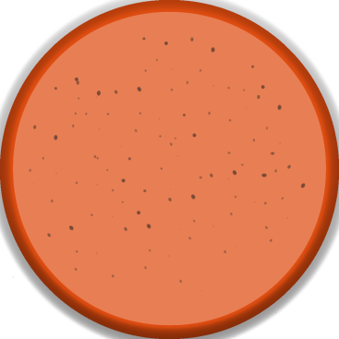

Art Style

Slide 11

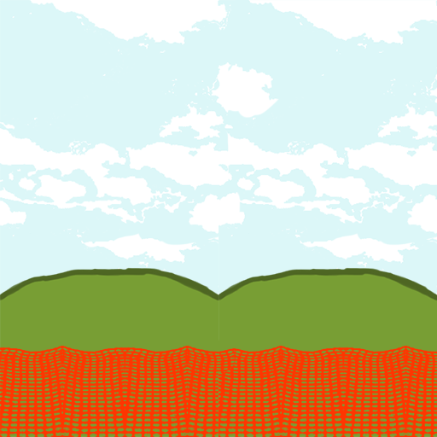
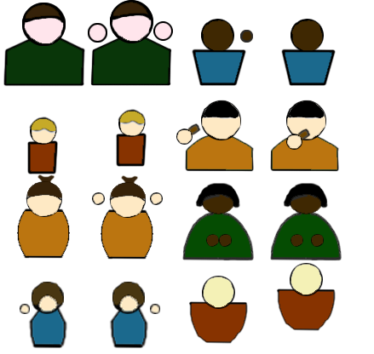


Background

Slide 12
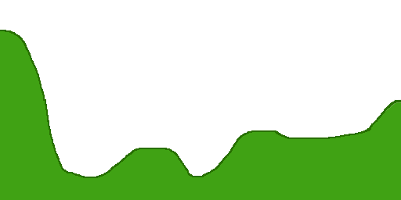

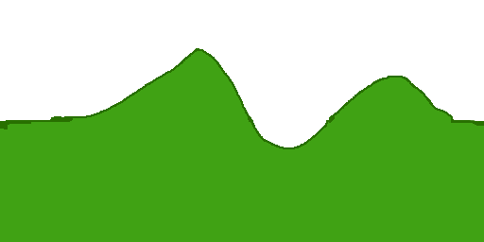
Track
Beginning Piece
Middle Piece Example
End Piece Example

Slide 13
Current Prototype

Slide 14
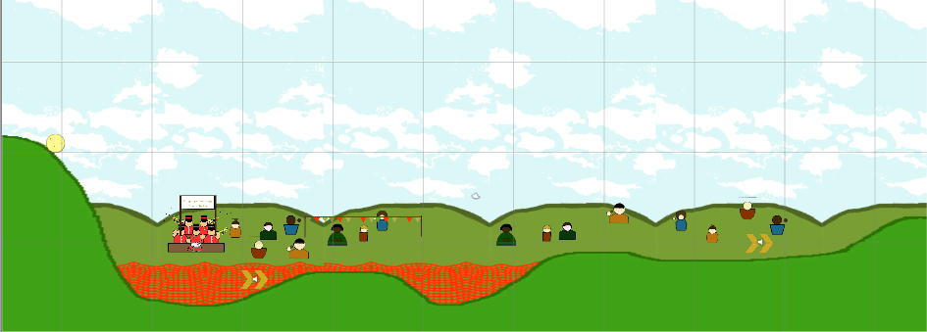
Affordance

Slide 15
Semi Modular Tiles

Slide 16
Management
Alex Polley: 33 Hours
Michael Curtis: 36 hours
Henry Crofts: 44 hours

Slide 17
Questions?

